Slide 1
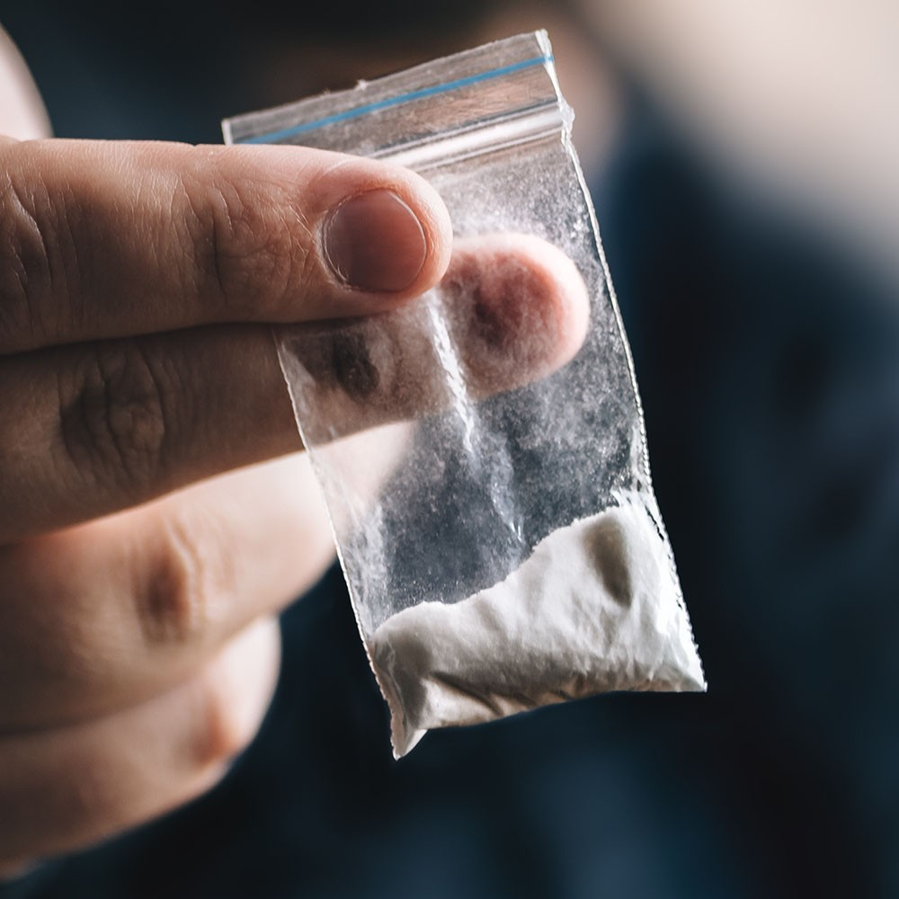
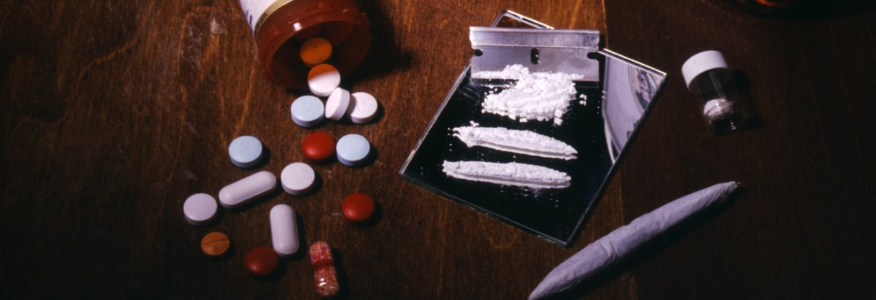
Drugs Overdose Deaths in USA
Awareness and Education
Increase Support Groups
Advocacy
Prevention Programs
Community Policing
Treatment Facilities
Naloxone Distribution*
Safe Disposal
Media Campaigns
Counseling Services
Crisis Hotlines
Team Members:
Supriya
David
Varun
Mohana

